Slide 1

Analysis of Delayed Flights
Janith Perera
COMP 4449
Summer 2022

Slide 2

Introduction
Aviation industry plays a critical role in the World’s transportation sector.
Lot of business relay various airlines to connect them with other parts of the world.
But several reasons may directly affect the airline services by means of flight delays.
Accurately predicting these delays will be beneficial to passengers to be well prepared and to airlines to respond to the potential causes of the flight delays in advance.

Slide 3
Purpose of the project
Build a model for predicting flight delays at the destination airport specifically for the month of January in upcoming years.
Exploratory data analysis on the variables to find out the tends and role in determining the flight delays.
Compare the prediction accuracy of the target variable which is arrival delays with using popular classification algorithms which are Logistics Regression, Stochastic Gradient Descent, Decision Tree, Random Forest, Support Vector Machine, Gradient Boosting and XB Boost.

Slide 4
Problem Statement
Using popular classification techniques, can we predict the possible flight delays based on factors like day of the week, date of the month, carrier, origin and destination etc.

Slide 5
Data
Downloaded from Kaggle.com
Originally collected from the Bureau of Transportation Statistics, Govt. of the USA.
Data contains all the flights throughout the United States in January 2019 and January 2020.
Includes 21 feature columns such as origin airport, destination airport, airplane information, departure time, arrival time and etc.
About 1.2 million flight information (instances)
Binary target variable.

Slide 6
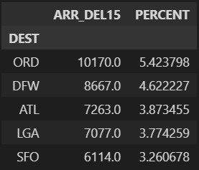
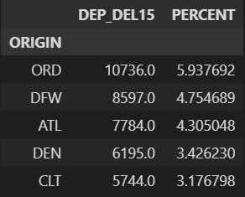
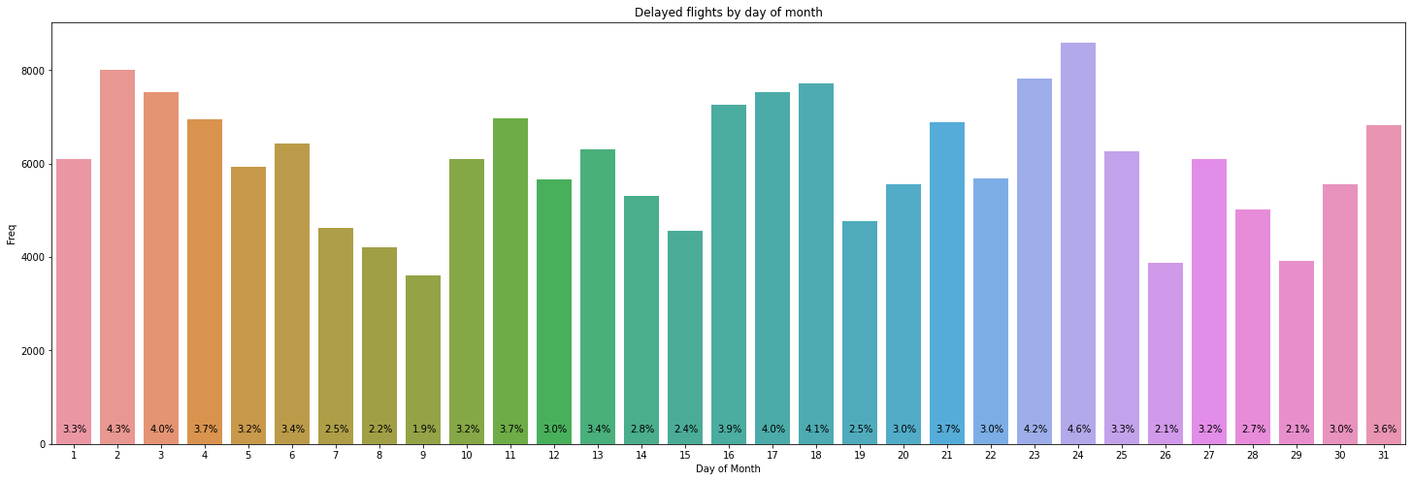
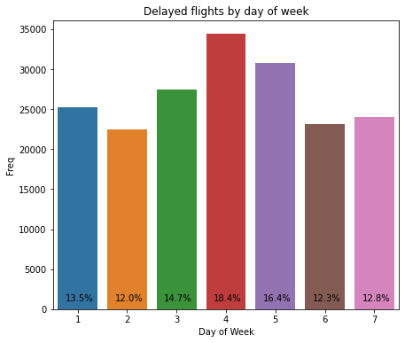
Exploratory Data Analysis

Slide 7
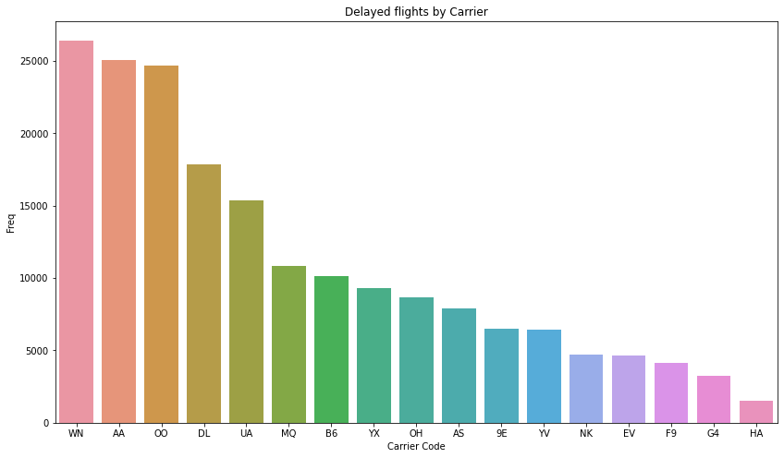
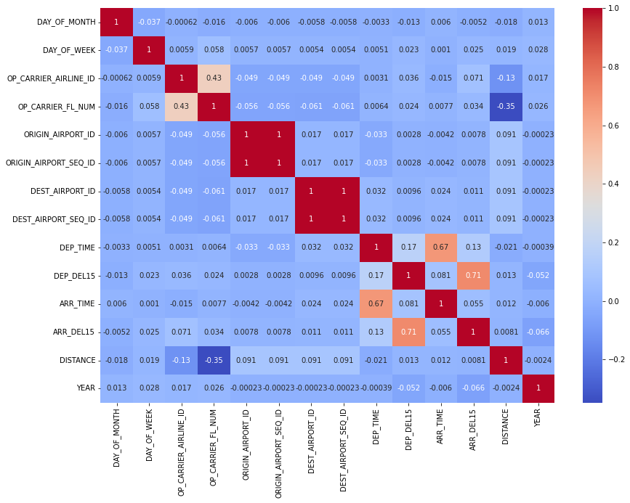
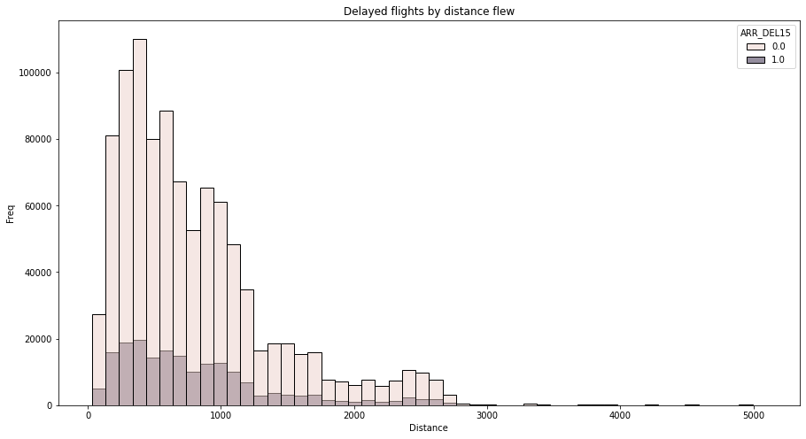
Exploratory Data Analysis

Slide 8
Dataset Preparation
Cancelled and diverted flights considered as delayed since those flights are negligible when considered to total dataset.
Rest of null values were less than 3% and dataset quit large, therefore flights with missing data removed.
Departure time and arrive time features transformed in to the time blocks.
Created separate features for origin and destination airport sequence numbers.
TAIL_NUM | 0.27%
DEP_TIME | 1.97%
DEP_DEL | 1.97%
ARR_TIME | 2.07%

Slide 9
Dataset Preparation
Some features dropped to reduce correlation between features
Changed categorical data into categorical data type
Dropped features | Reason
Unnamed: 21 | Do not carry any data
CANCELLED, DIVERTED | Data merged to target feature
DEP_TIME, ARR_TIME | Transformed in to time blocks
OP_CARRIER | Same data as OP_UNIQUE_CARRIER
OP_CARRIER_AIRLINE_ID | OP_UNIQUE_CARRIER is a subset of this
ORIGIN_AIRPORT_ID, ORIGIN_AIRPORT_SEQ_ID, DEST_AIRPORT_ID, DEST_AIRPORT_SEQ_ID | Created separate features

Slide 10
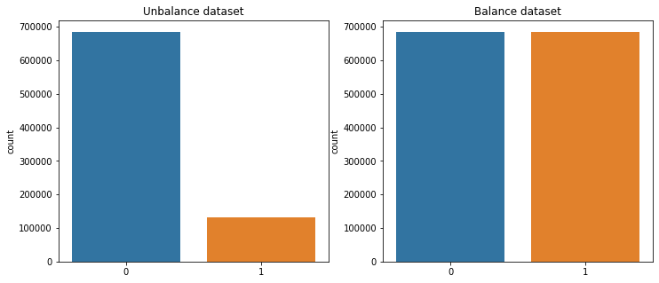
Dataset Preparation
LabelEncoder() was applied for all categorical features.
LabelBinarizer() was applied to the target feature.
RandomOverSampler() was applied to balance the dataset.

Slide 11
Model Performance
Due to whole dataset is quite large, it took unreasonable time in local computer. Therefore, random 10% faction used to evaluate the models.
For initial evaluation, 5-fold cross validation model used with seven popular classification models.
Among those models, Random Forest classification model selected to hyperparameter tuning.
 | Logistics Regression | SGD Classifier | Decision Tree Classifier | Random Forest Classifier | SVC | Gradient Boosting Classifier | XG Boost Classifier
Accuracy | 0.85 | 0.62 | 0.95 | 0.98 | 0.53 | 0.85 | 0.90
Precision | 0.95 | 0.72 | 0.91 | 0.96 | 0.53 | 0.95 | 0.93
Recall | 0.74 | 0.61 | 0.99 | 0.99 | 0.53 | 0.74 | 0.86
F1 score | 0.83 | 0.56 | 0.95 | 0.98 | 0.53 | 0.83 | 0.90

Slide 12
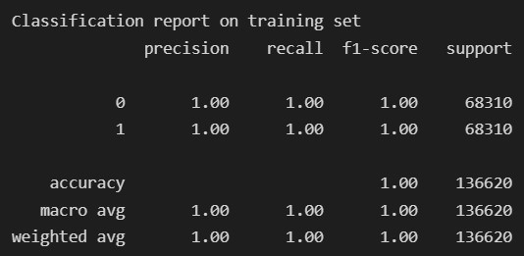
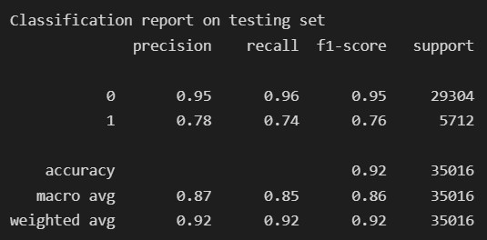
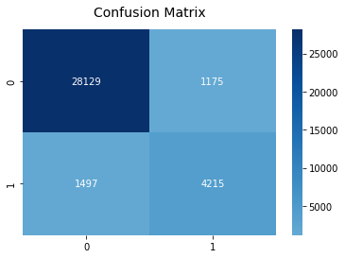
Results
Hyperparameter tuned Random Forest classification model gives the overall accuracy score of 1.00 on training set and 0.92 on testing set.​

Slide 13
Conclusion and Lessons Learned
I would recommend using a hyperparameter tuned Random Forest Classifier to assist in predicting flight delays at the destination airport for the month of January in upcoming years based on physical factors.
It is better to include weather conditions in to this analysis because weather is one of the most influencing factor for flight delays.
Further, if we can consider flights flew in whole year, we may find some patterns of delaying.

Slide 14


Thank you

